Slide 1


Urban Planning Dashboard:TerraNova Galaxy
Integrating NASA Earth Observation Data for Sustainable Cities
A project designed for urban planners, sustainability analysts, and data scientists to leverage high-resolution satellite imagery and data products for evidence-based decision-making in rapidly evolving metropolitan areas.
Notes:
1

Slide 2


Foundations of the Sustainable Urban Dashboard Initiative
This initiative aims to transform traditional urban planning processes by anchoring them in robust, globally consistent Earth observation data. We are moving beyond anecdotal evidence to create dynamic, data-driven insights for sustainable metropolitan growth.
Global Urban Analysis
Improving Urban Planning
Leveraging NASA Earth Data
Our core goal is to analyze 50 selected global cities to identify patterns, evaluate current urban health, and model potential growth trajectories. This comparative analysis provides transferable insights for urban centers worldwide.
The dashboard serves as a central hub for metrics across population dynamics, land use efficiency, extent of built-up areas, and critical environmental sustainability indicators, ensuring holistic decision support.
We integrate publicly available, high-quality NASA datasets, including MODIS for terrestrial metrics, OMI for atmospheric composition, and specialized population and land change products.
Key Datasets for Environmental Assessment
MODIS (Moderate Resolution Imaging Spectroradiometer): Used for quantifying vegetation health (NDVI) and urban heat island effects (Land Surface Temperature/LST). Crucial for assessing green space viability and thermal comfort.
OMI (Ozone Monitoring Instrument): Provides detailed data on key atmospheric pollutants, such as NO2 and aerosols. Essential for calculating city-level air quality metrics and understanding public health impacts.
SEDAC (Socioeconomic Data and Applications Center): Incorporates high-resolution global human population datasets to map population density and urban growth patterns, linking demographic pressures to environmental stress.
Trends.Earth / MASADA: Provides sophisticated analysis of land degradation and land cover change, specifically identifying and tracking the expansion of impervious and built-up areas over time.
Introducing the Z Metric: The Consolidated Sustainability Score
The Z Metric is a composite index designed to provide a single, actionable score for the environmental sustainability of a metropolitan area. It mathematically combines and normalizes four essential inputs:
Z Metric Components: Normalized Difference Vegetation Index (NDVI), Air Quality Index (derived from OMI data), Surface Temperature Anomalies (LST), and Built-Up Density. A higher Z score indicates greater environmental health and sustainability performance.
Notes:
2

Slide 3
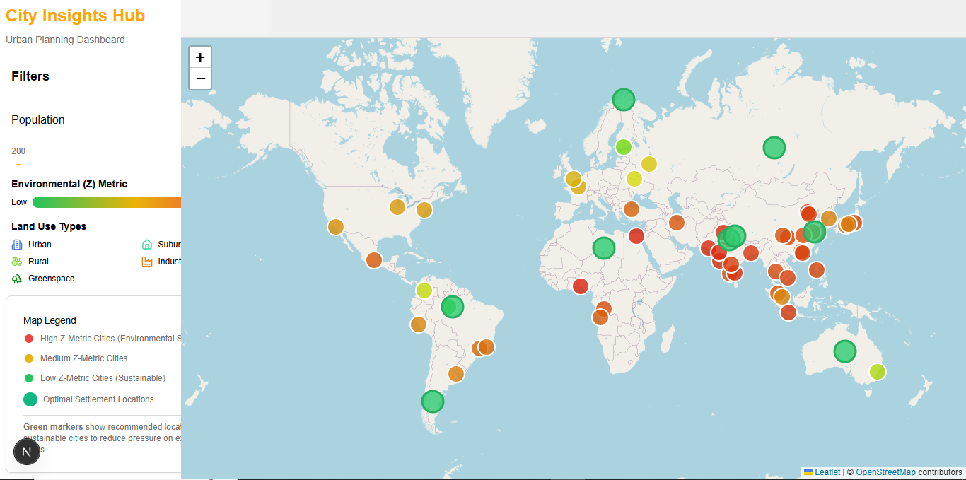
USAGE DEMO
This is the opening of dashboard alongside map marked with top 50 cities

Slide 4
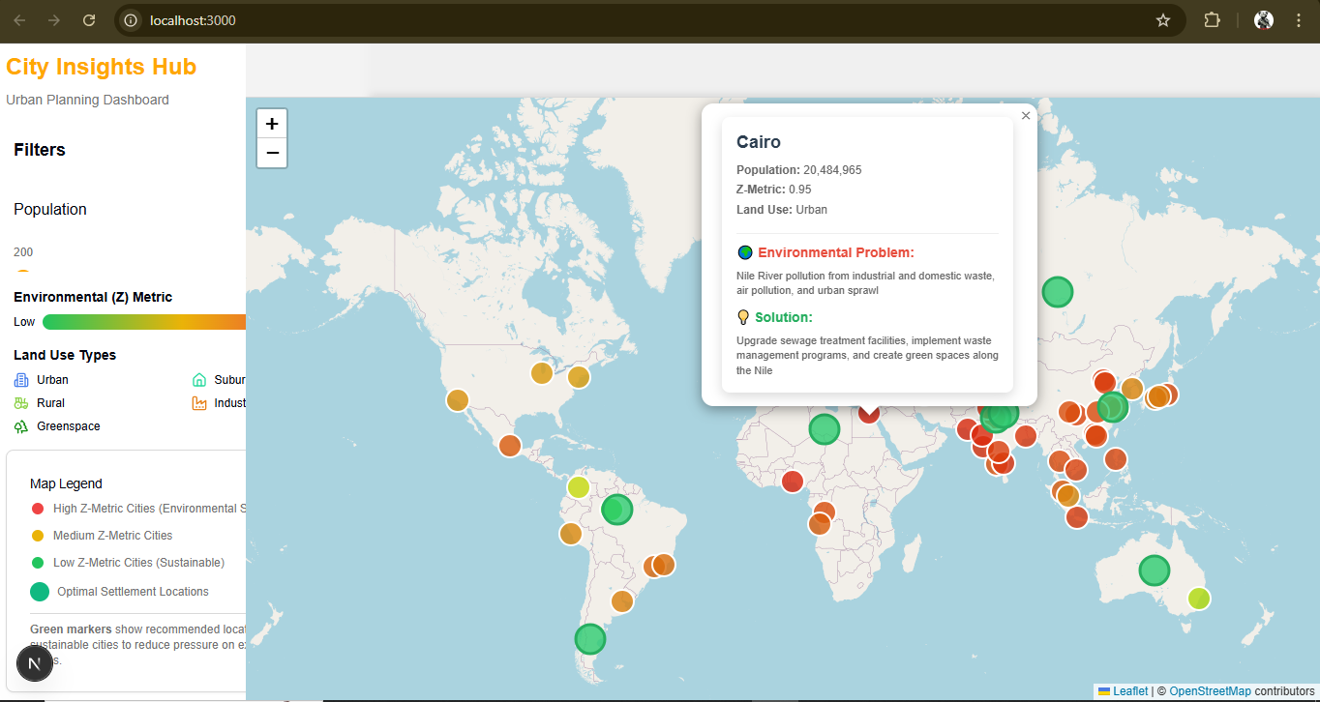
Clicking on a dot gives the citiies population along with environmental quality major problems faced and major solutions

Slide 5
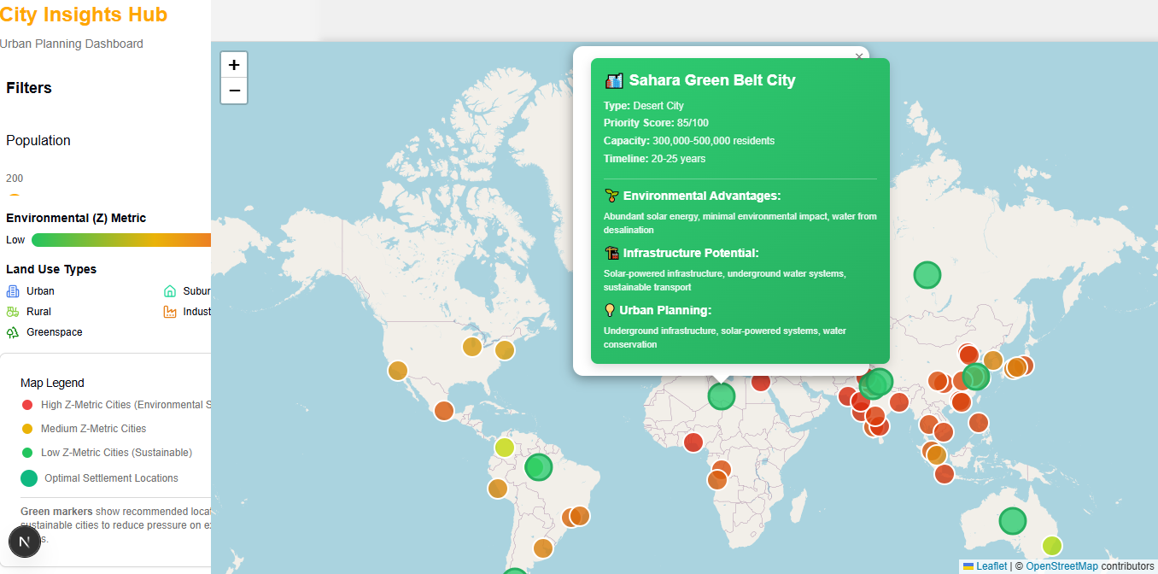
The green dot represent planned future cities option which urban planner may find benificial along with why cities are great for environment

Slide 6
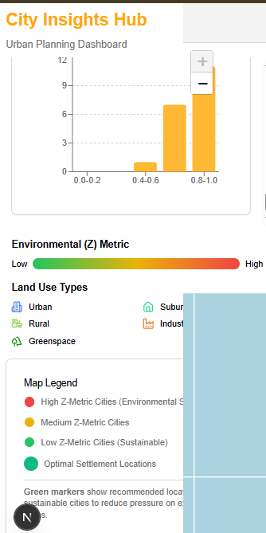
interactive filters charts and legend make the website more functional

